Slide 1

Insert Your Name, Title, and Organization
Notes:
This presentation is intended for providers to use to inform school/district administrators about the IYS and encourage participation. We recommend bringing along IYS school information packets to provide to your audience (school administrators).
Providers should be very knowledgeable about the IYS prior to delivering this presentation, review the information on the IYS website (http://iys.cprd.illinois.edu), and anticipate questions and responses from the audience.
Insert your name, title and organization on this slide to represent that you are presenting this information

Slide 2
What is IYS?
The Illinois Youth Survey (IYS) is a self‐report adolescent survey administered in Illinois schools. It is funded entirely by the Illinois Department of Human Services (IDHS).
Conducted since 1993.
The Center for Prevention Research and Development (CPRD) at the University of Illinois has been the state contractor since January 2011.
All public and private schools in Illinois are welcome to participate.
Notes:
Chestnut Health Systems was the original contractor for the IYS from 1990 to 2010. CPRD was awarded the contract in January 2011 based on a competitive bid process.
CPRD has been involved in the IYS since 1998, before it became the IYS contractor, doing various tasks related to processing and scanning survey forms, creating the original individual school reports, drawing the state random samples, and preparing the state sample data for analysis.

Slide 3

Purpose
IYS is designed to gather information from youth about a variety of health and social indicators, including:
  Substance use (ATOD)
  Violence and bullying
  Perceptions of school climate
  Depression
  Nutrition and fitness
Notes:
Each administration year, new questions are added and others removed, keeping pace with current issues while being mindful of survey length and grade level appropriateness.
Thus, the survey attempts to reflect changes in substance use behaviors, attitudes and perceptions, and other indicators.

Slide 4
How is IYS Administered?
The survey is given to students in 8th, 10th, and 12th grades.
It is administered in the spring of every other school year during even numbered years (2024, 2022, etc.).
  The school chooses a date between January and May to administer the survey.
It takes approximately one class period, or about 40 to 45 minutes.
There is no cost to participate or to receive results.
Notes:
Most schools survey the ‘regular’ IYS grades, which are 8th, 10th, and 12th.
Schools/districts are not required to administer the survey at each of these grade levels, although we recommend it. When data is collected every 2 years, the survey will always be administered to the same students, more accurately tracking trends over time (2022’s 10th graders will be 2024’s 12th graders).
Some high schools survey more grades (all their grades) and that’s OK too.

Slide 5
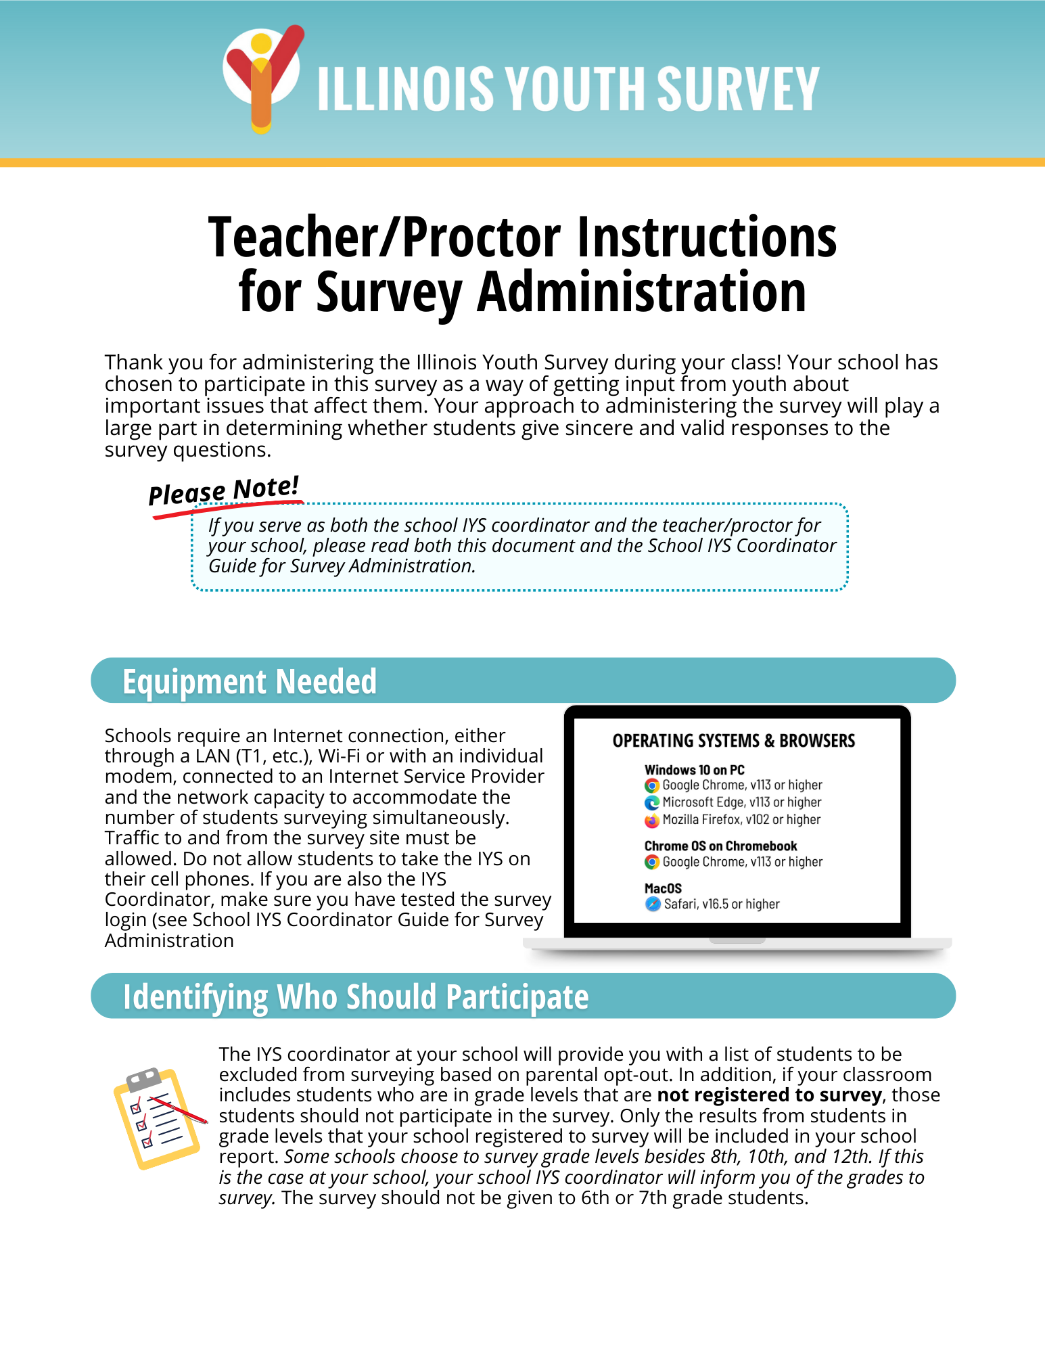
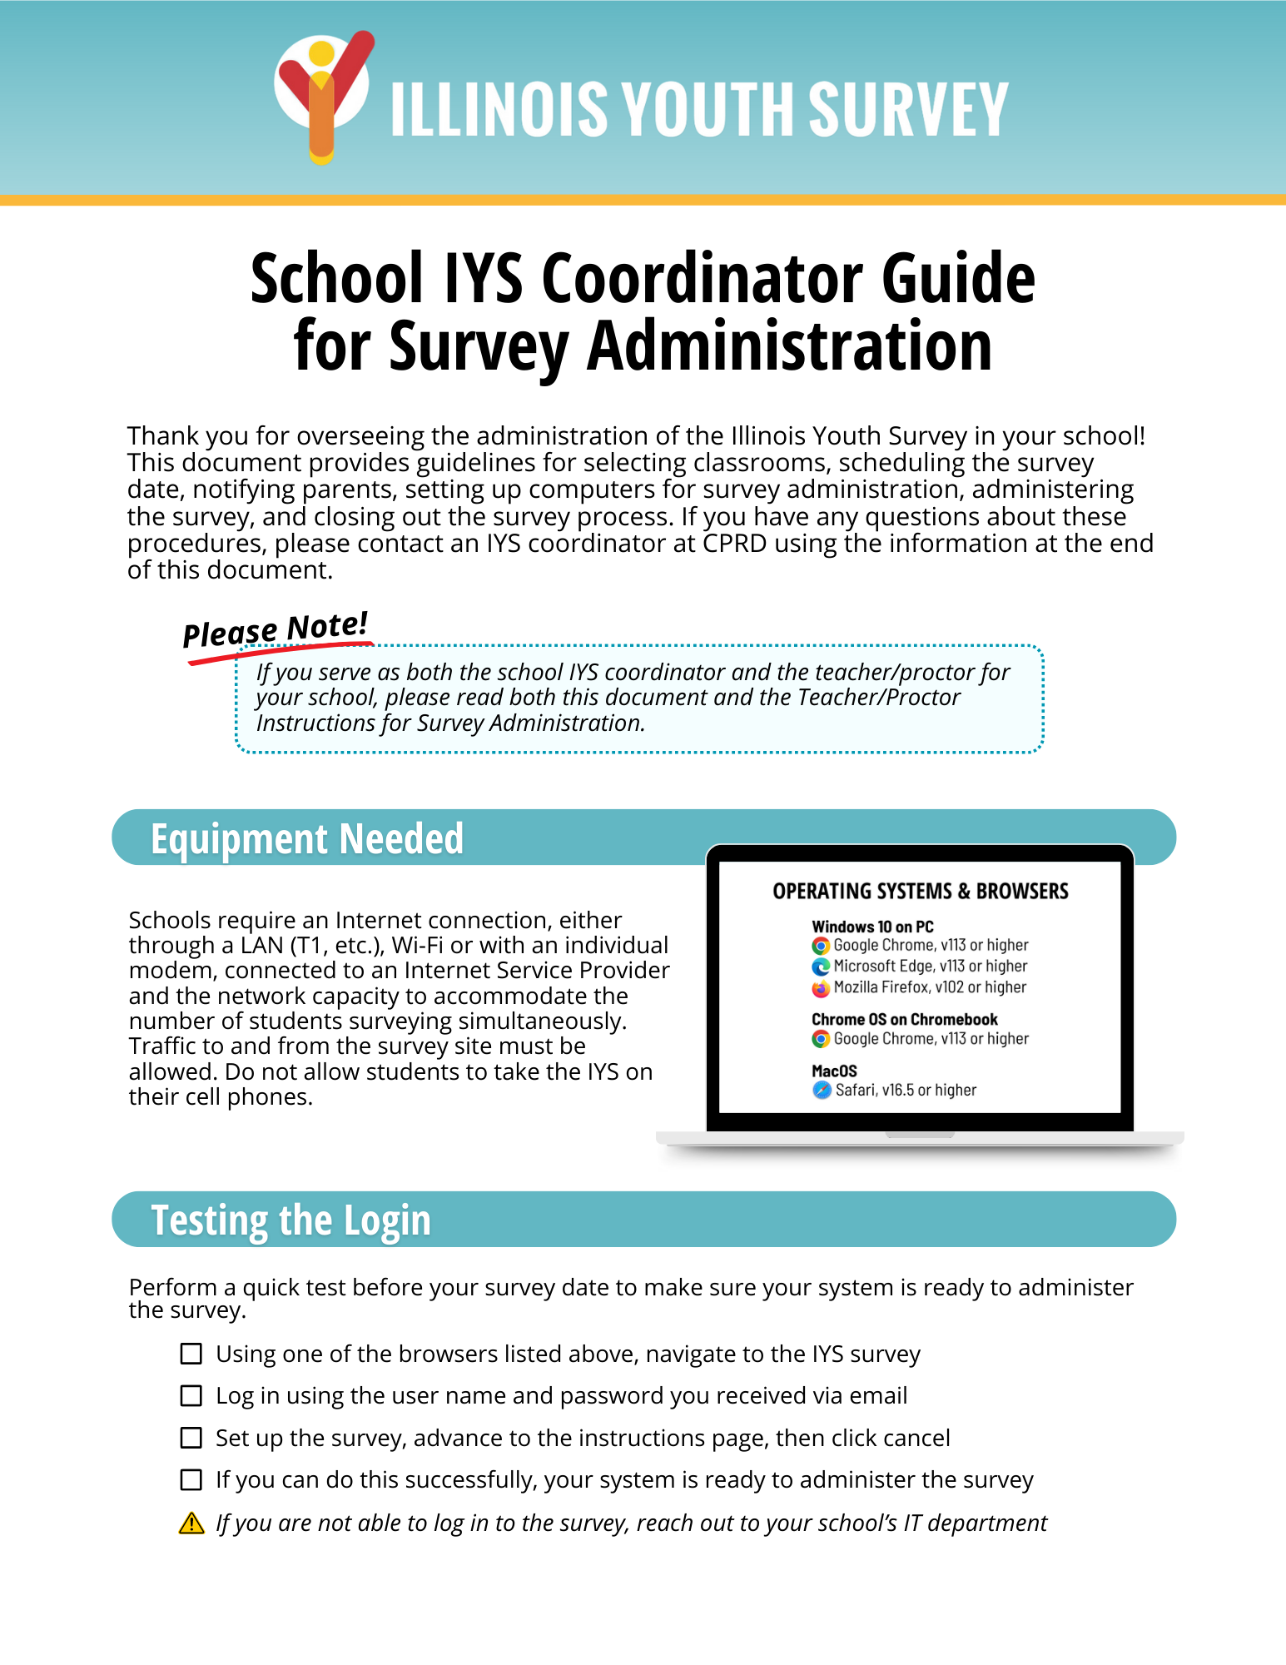
Flexibility
IYS is available in English or Spanish.
Schools receive everything they need to survey about 30 days before their intended survey date.
    Survey login
    Links to instructions
    Parent notification form
Notes:
The English version of the survey is available in paper or online format.
The Spanish version of the survey is available online only (for confidentiality reasons).
For both survey modes, CPRD provides everything needed to administer the survey.

Slide 6
Validity
IYS produces valid results when administered according to survey directions.
Questions are carefully designed and tested.
Individual surveys are assessed for completeness, and procedures are followed for reporting missing data and inconsistent responses.
Studies of similar surveys comparing self-report to actual use have shown substantial validity.
Patterns of use revealed by the IYS are consistent with other measures.
Notes:
Completed surveys are assessed for completeness and the data collected is cleaned by CPRD.
Two documents on the IYS website (https://iys.cprd.illinois.edu/results) provide more detail:
* The survey validation document outlines the process for individual surveys.
* The missing and inconsistent data document details data cleaning procedures.

Slide 7

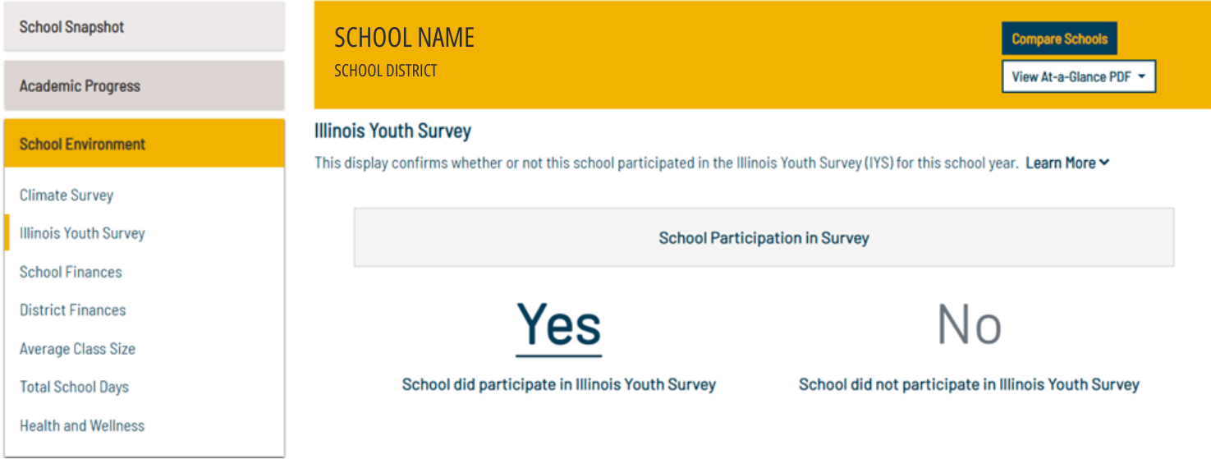
Illinois School Report Card
IYS participation is on ISBE’s Illinois Report Card!
Notes:
IYS recently became part of the Illinois School Report Card. 2022 survey participation appears in the School Environment section of the current report card.

Slide 8
Why is IYS Data Important?
IYS provides data to schools about what their students are doing and thinking in regard to emotional and health-related issues.
Research shows that cost-effective youth prevention strategies should be based on local, up-to-date data from youth.
Data gathered through the IYS can be used to guide planning for effective prevention strategies to ultimately increase academic performance and healthy behaviors.
Notes:
Schools want to know how the data will help them. It is easy to assume we know, but data can uncover what we don’t know.
Presenter: If you can add specific ways that schools will be able to use the data (aside from assisting you in your efforts), then you should include those ideas.

Slide 9

Why is Prevention Important?
Adolescent substance use, bullying, and other emotional and health issues are related to negative school outcomes:
  Absenteeism
  Academic difficulties
  Lack of motivation
  Interpersonal violence
Notes:
Presenter: It is important to help school administrators see the connections between substance abuse, the school environment and student performance. Schools need to know how prevention can improve the school environment and benefit student performance.

Slide 10
Individual School Results
Each participating school receives a school report in about 6 weeks.
  The school report covers all survey items and includes state comparisons for selected items.
  Schools that participate in every administration can measure progress over time.
Local data can be useful for a variety of school and community planning efforts.
It can be useful for grant reporting purposes and to help leverage additional funding.
Notes:
Each school receives a report of their school’s data.

Slide 11

Confidentiality
Participation is anonymous—the identity of the youth who participate is not collected or revealed.
IYS produces reports at several levels; distribution rules ensure confidentiality.
  School reports: compiled survey data is shared only with the school principal.
  District reports are produced if there are at least two participating schools at any grade level; data is shared only with the district superintendent.
  County reports are produced if there are at least two participating districts in the county.
Notes:
Students and parents can be assured that the survey is anonymous and responses cannot be linked to them.
District and county-level reports are only produced there is enough participation at each level to protect anonymity.
As more schools participate, regional and state profiles become more valid.

Slide 12
Benefits and Bottom Line
For the price of 1 class period every 2 years, schools and their community partners can receive essential information to:
  Compete for grants that infuse needed resources
  Reduce barriers to academic success
  Track changes in health behaviors
  Guide local community coalition efforts

Slide 13

Resources
[INSERT YOUR CONTACT INFORMATION]
Notes:
CPRD’s toll free number is answered during business hours and calls are usually returned on the same day.

Slide 14

Questions?

